Slide 1

Rapid Structural & Functional Annotation of a Gene
Kelvin Koser & Michael Welsh
BMES 550
Fall 2022

Slide 2
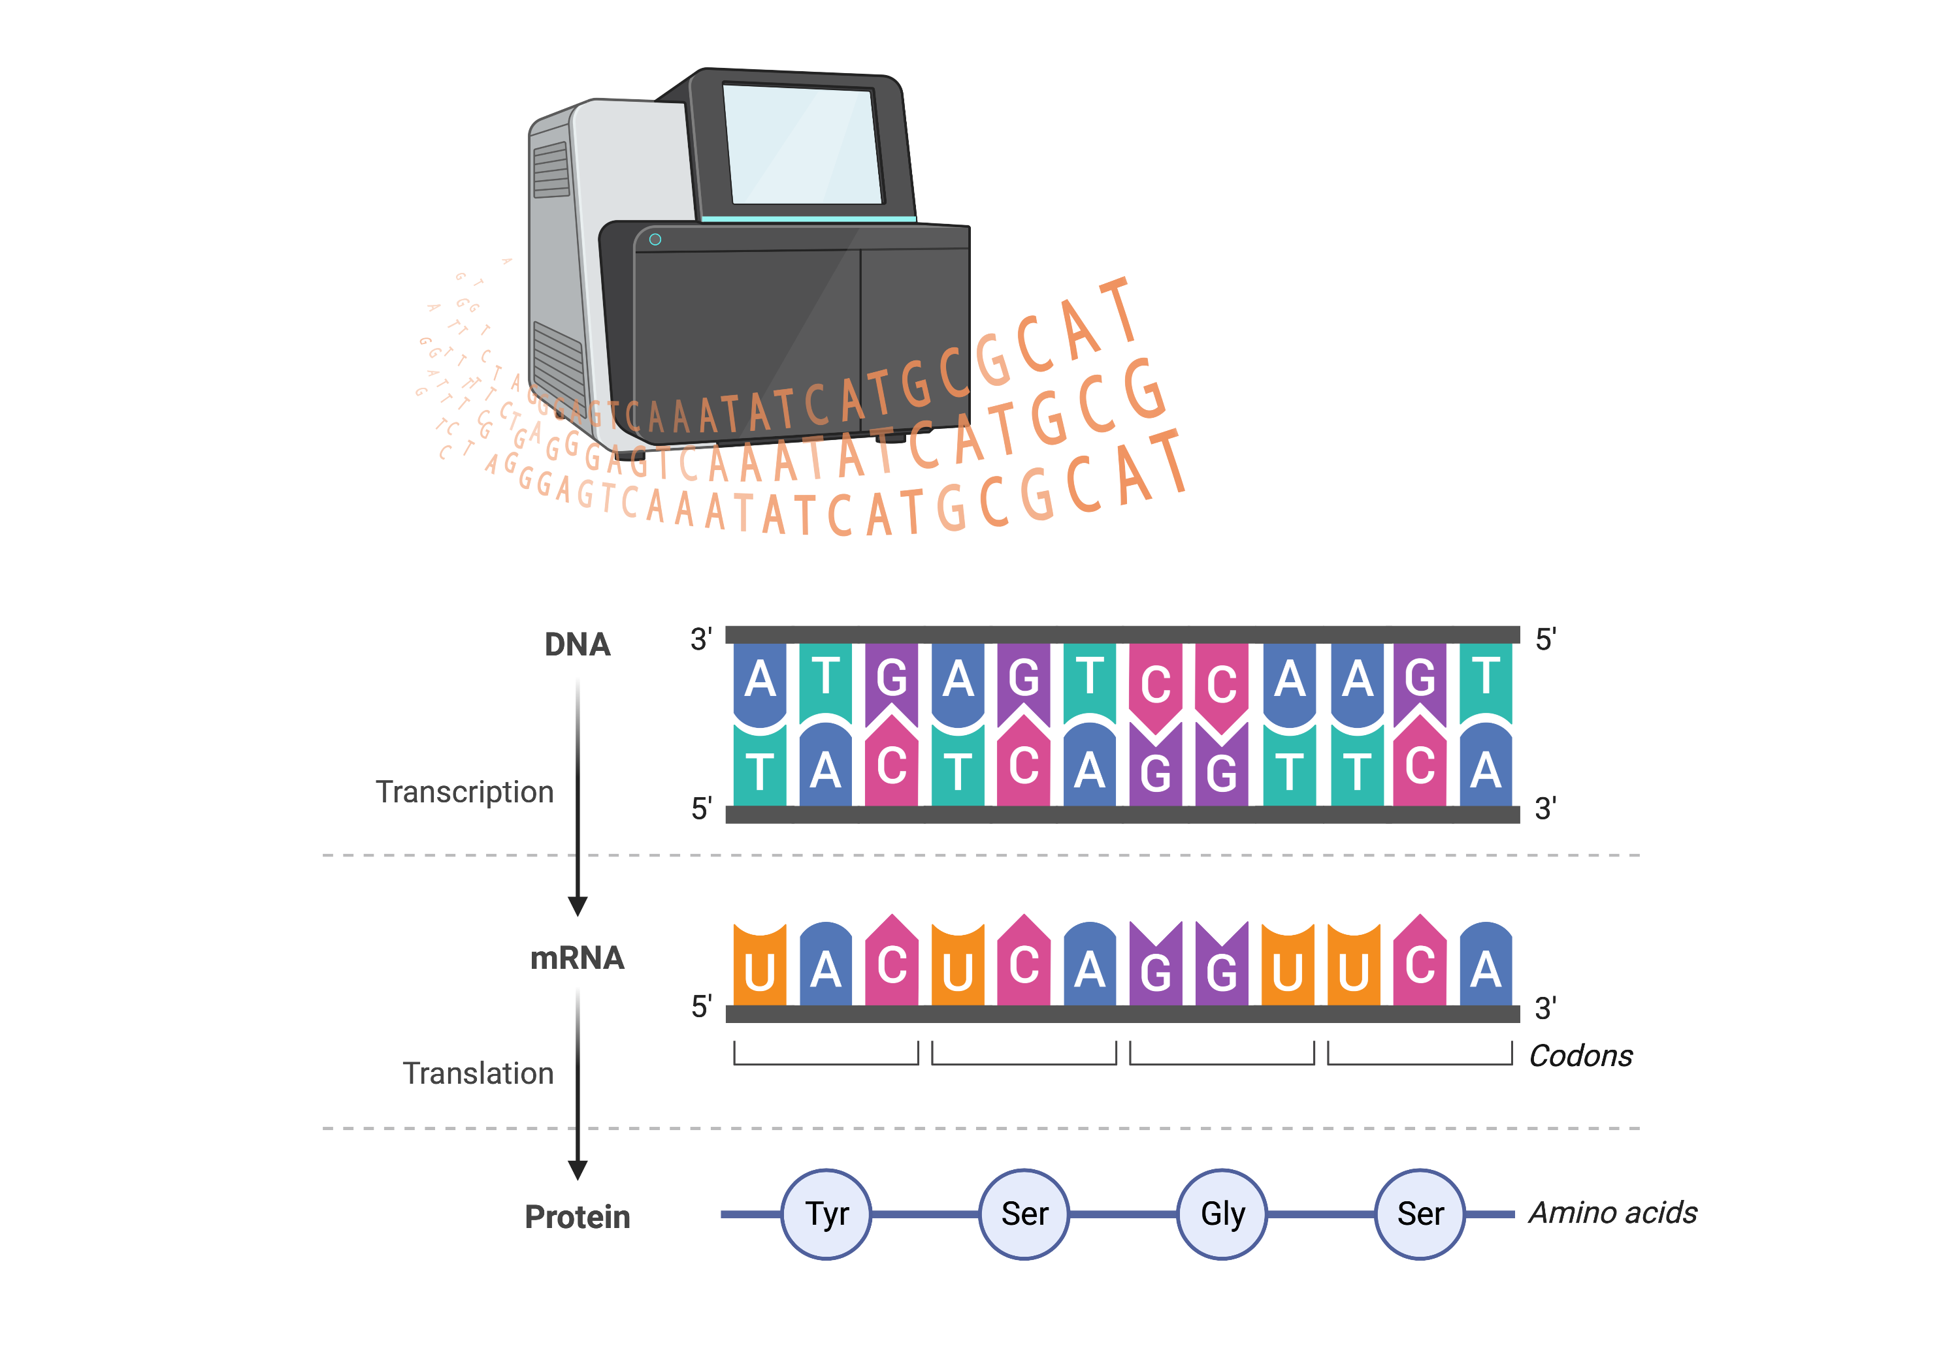
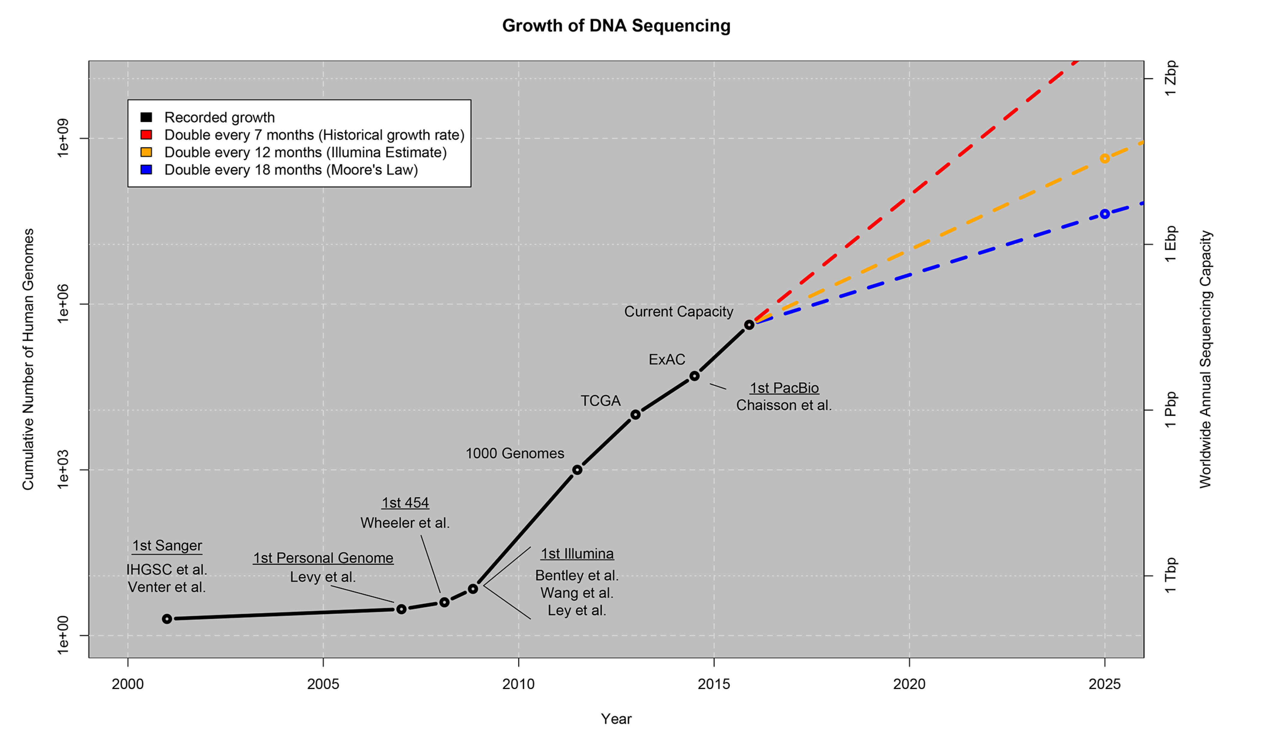
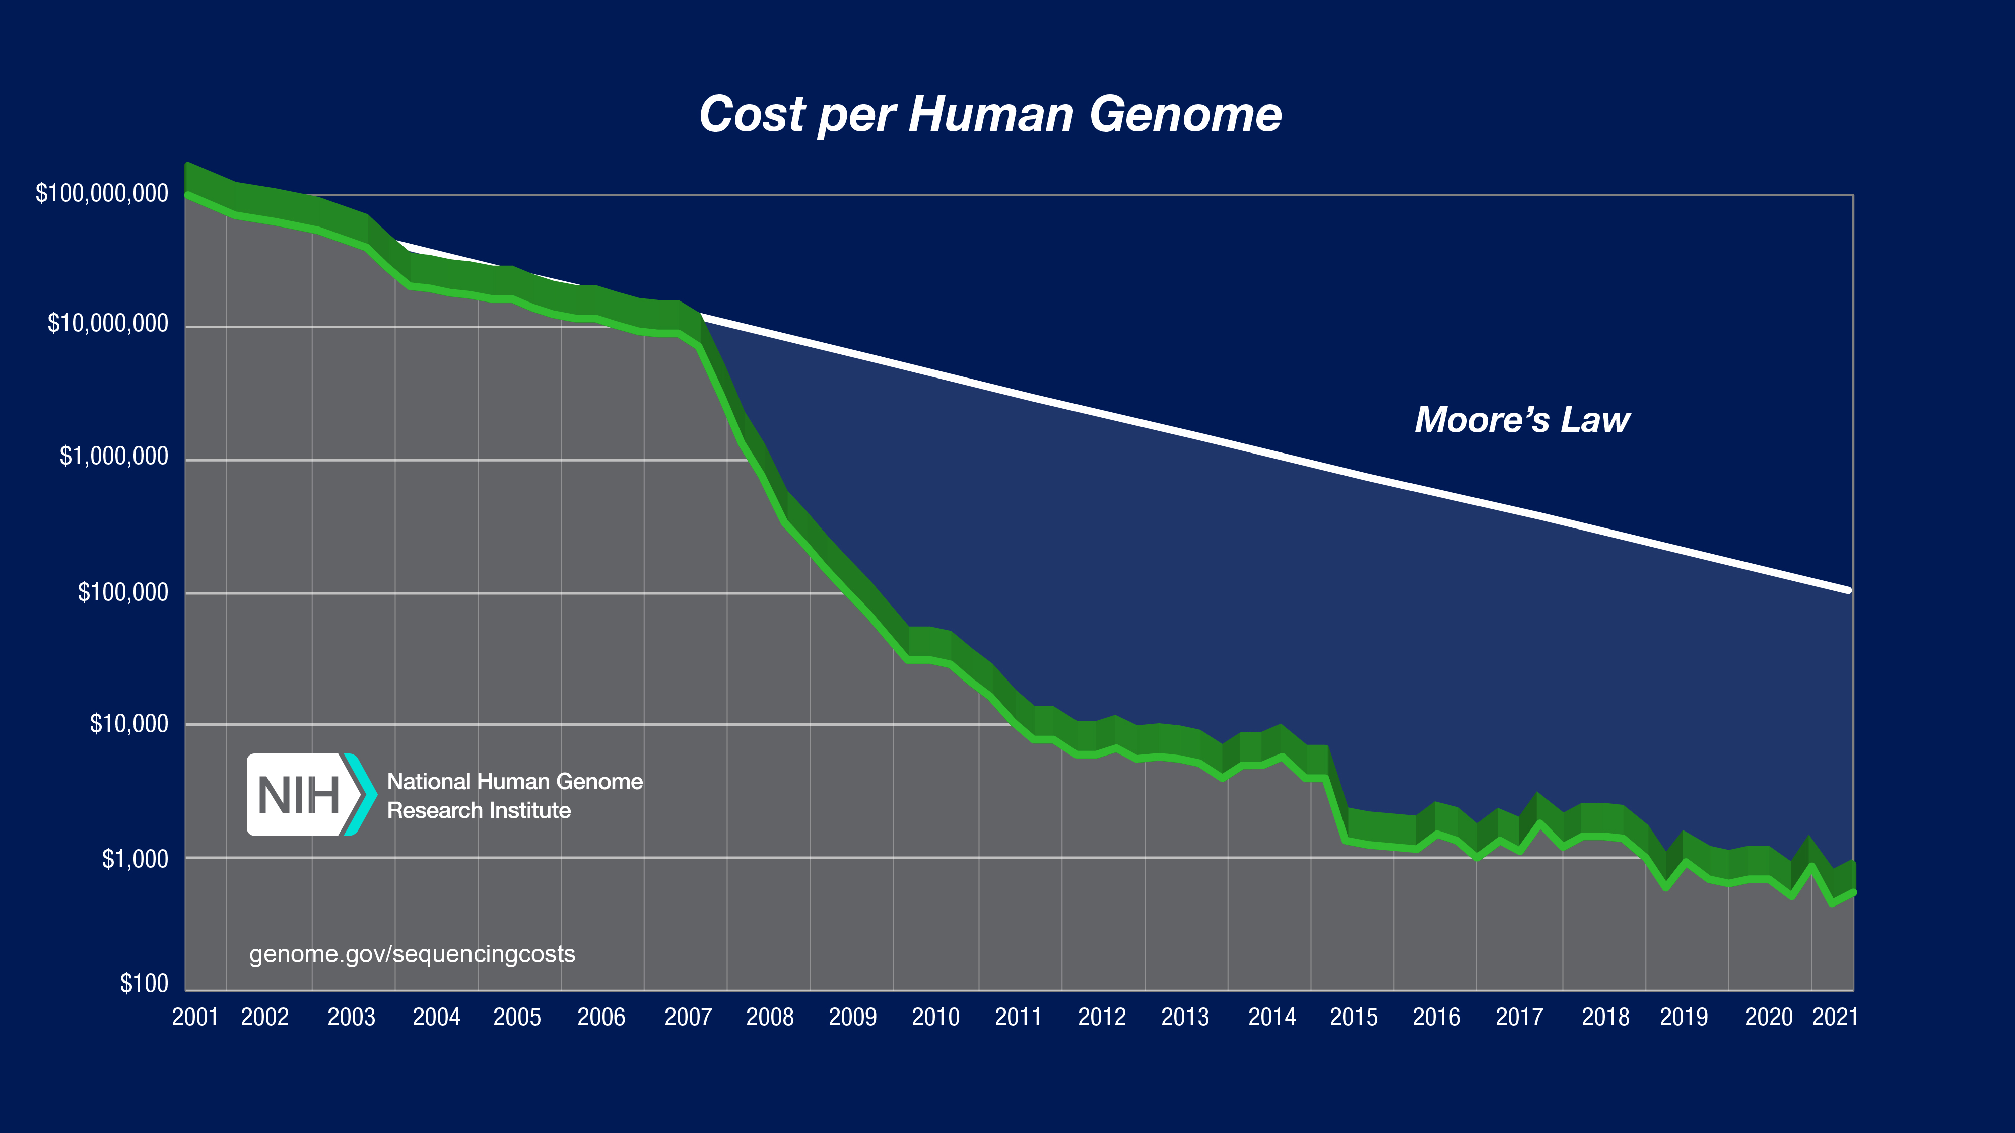
Sequencing & “Big Data”
Dramatic increase in sequenced genomes
Technological advances
Decreased cost
Increased public interest
Created with BioRender.com
Stephens et al, 2015
Credit: genome.gov/sequencingcosts

Slide 3
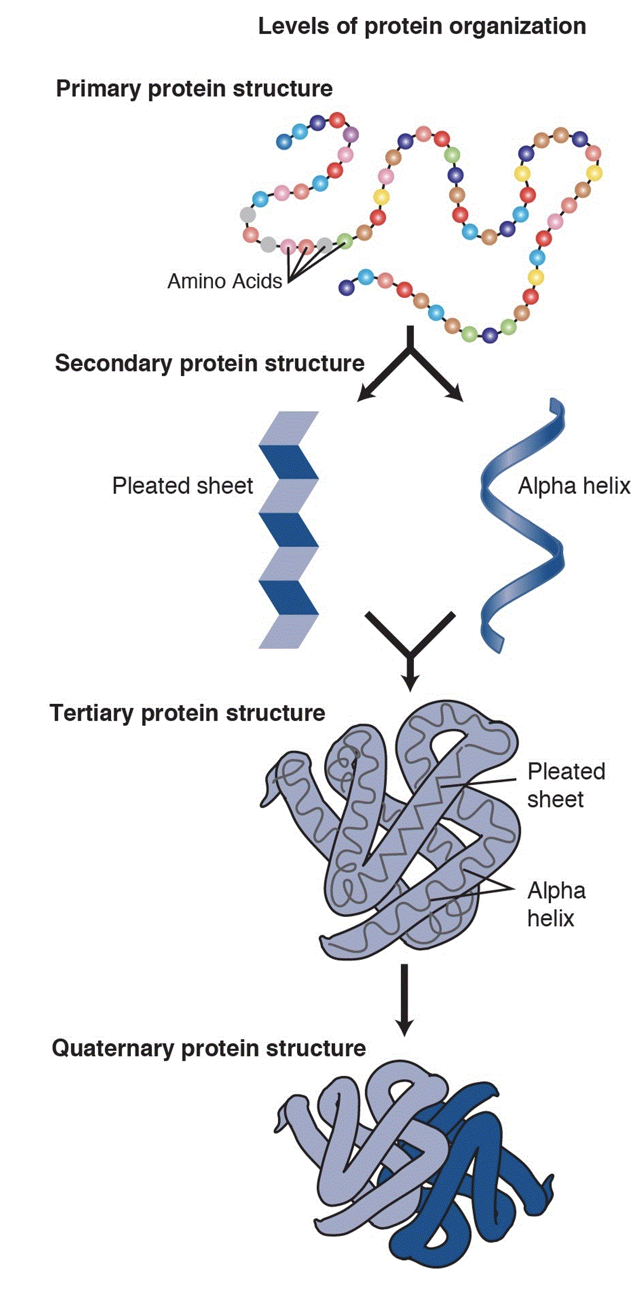
Genomic sequences have many potential uses
Extract DNA from cell
Ancestry & relatedness
Determine RNA & protein sequences
Infer functionality of encoded protein
Predispositions to disease
DNA Sequence
The Central Dogma
Next?
Once a genome is sequenced, a critical next step is annotating the genes present, as well as their functions
Created with BioRender.com
Credit: https://www.genome.gov/genetics-glossary/Protein

Slide 4
BLAST is a homology-based alignment tool
Aligns a novel/unknown sequence against a database of known sequences
Which gene(s) are most similar based on sequence?
Can infer functionality of resulting protein from unknown sequence
Complicated by a variety of factors:
Sequencing tech employed
Location of gene/sequence in chromosome
Multiple metrics to assess by
Unknown sequence (Query):
A
C
G
T
T
G
A
A
T
C
G
T
Database of known sequences:
T
A
T
G
C
T
G
A
G
T
C
A
A
A
G
C
T
G
T
C
T
A
G
T
G
T
C
G
A
T
T
A
A
T
C
G
G
C
A
T
T
G
A
T
T
A
G
C
G
C
T
G
T
A
A
A
T
C
T
G
C
G
A
G
A
T
G
T
T
T
C
A
G
A
G
T
T
A
C
A
T
C
G
T
A
C
G
T
T
G
A
A
T
C
G
T
C
C
G
C
T
G
G
A
T
C
T
T
G
G
G
C
T
G
T
A
T
C
A
T
Public databases of known sequences are available via NCBI

Slide 5

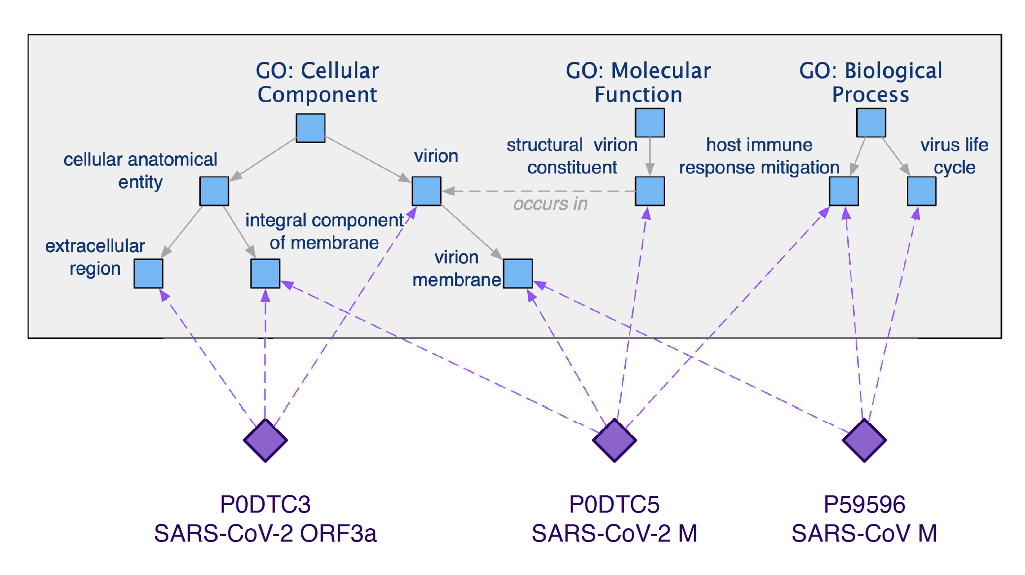
Gene Ontology ascribes functional annotations to biological sequences
Comprehensive database of known gene & protein functions
Based on an expansive collection of scientific literature
3 classes of annotations:
Molecular Function (MF)
Biological Process (BP)
Cellular Component (CC)
Popularly used in enrichment analyses
Which functions are affected based on experimental test?
Hao et al, 2015

Slide 6
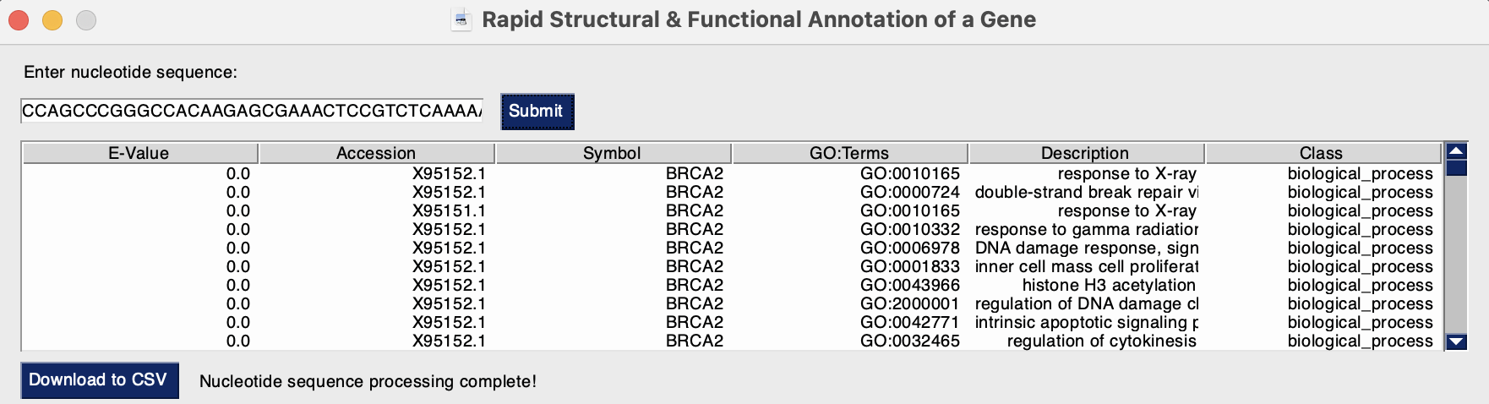
Problem & Motivation
Problem
Determining the structural and functional annotations of a novel sequence requires use of multiple computational tools
Goal
Create a tool that can streamline structural & functional annotation of a sequence
Benefits
Streamlines multiple algorithms and databases, increasing efficiency
Outputs a neat table with a downloadable .csv option
Provides a user-friendly graphic user interface
Sample data:
This would be helpful for biologists who are interested in determining the identity and function of a novel or unknown gene/sequence

Slide 7
BLAST
Database of known sequences (from NCBI):
Unknown Sequence (Query):
T
A
T
G
C
T
G
A
G
T
C
A
A
C
G
T
T
G
A
A
T
C
G
T
A
A
G
C
T
G
T
C
T
A
G
T
G
T
C
G
A
T
T
A
A
T
C
G
G
C
A
T
T
G
A
T
T
A
G
C
G
C
T
G
T
A
A
A
T
C
T
G
C
G
A
G
A
T
G
T
T
T
C
A
G
A
G
T
T
A
C
A
T
C
G
T
A
C
G
T
T
G
A
A
T
C
G
T
C
C
G
C
T
G
G
A
T
C
T
T
G
G
G
C
T
G
T
A
T
C
A
T
Homology-based search

Slide 8
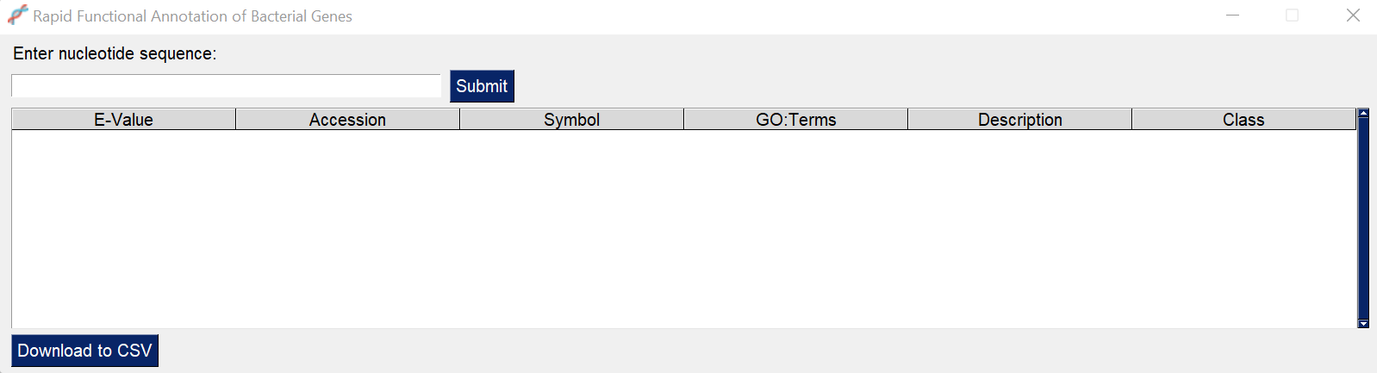
Experiments & Methods
Using NCBI database of reference nucleotide sequences
Novel sequence data (e.g. done via sequencing in a lab)
Usage:
Input nucleotide sequence (ex: AATCG)
Hit the submit button
Observe results
Optionally download to CSV via button
2
1
3
4

Slide 9
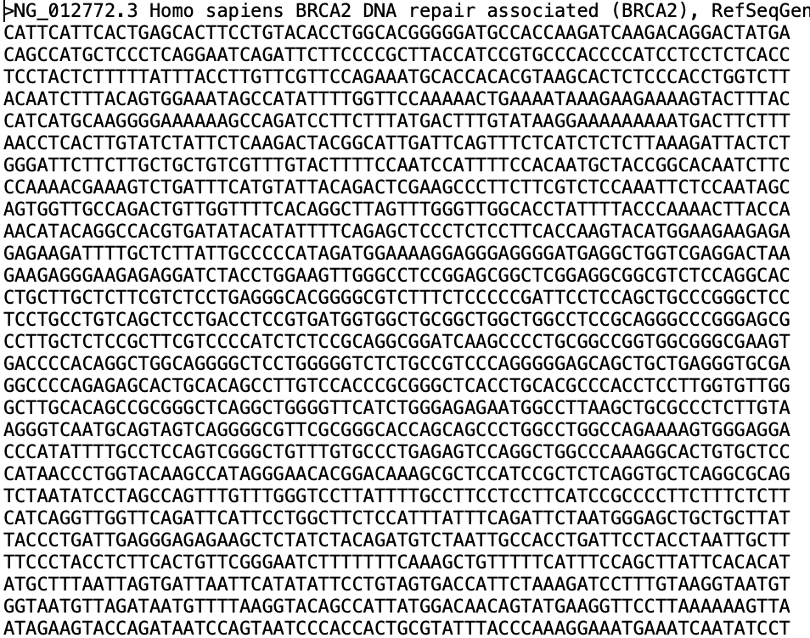
Workflow
DNA Sequence Provided
BLAST Sequence
Final DataFrame
Can either be typed in entry box or FASTA file submitted
Parses results based on E-value (probability metric)
Query BLAST Results
Can be saved as a .csv file
Outputted to GUI
ID GO terms (and their descriptions) relevant to each nucleotide "hit"
Aligns DNA sequence with sequences in database
Use cached results if available, thus bypassing these steps

Slide 10
Software Design – Dependencies
Biopython - tools for biological computation, like BLAST
Goatools - GO term handling
Sqlite3 - SQL interfacing variant
Pandas - tabular data wrangling
Numpy - fast numerical computation methods
PySimpleGUI - lightweight wrapper built upon native Tkinter for GUIs

Slide 11
Software Design – Frontend/Backend
Frontend
Built using lightweight PySimpleGUI for easy installation via PIP/Conda
Main thread handles GUI-related tasks; separate thread made for backend processing if cache-miss
Checks cache for user-inputted nucleotide sequence
A new thread is spawned for backend processing if cache-miss
Displays (and caches if not already cached) the nucleotide sequence results
User can optionally download the results to a timestamped CSV
Backend
Handles overhead of BLAST usage and GO querying given a nucleotide sequence
Connected to frontend via "process" function

Slide 12
Software Design – Exception Handling
Exceptions are ubiquitous
Tool catches all exceptions, and displays them on the GUI if possible
Makes it easy to interrupt chain of command without the frontend needing to know the backend internals, and vice-versa

Slide 13
Database Schema
Gene Ontology Database
Table 1: Gene Annotation |  | Table 1: Gene Annotation
uniq_ID | Symbol | nt_accession | GO: Term
1 | PARQ3 | NC_000004.12 | GO:0009387
2 | PARQ3 | NC_000004.12 | GO:0002020
3 | A2M | NC_000012.12 | GO:0005749
Table 2: Gene Ontology
GO: Term | Description | Class
GO:0009387 | Regulation of Cellular Process | Biological Process
GO:0007286 | spermatid development | Biological Process
GO:0031528 | microvillus membrane | Cellular Component
Derived from: gene2accession.tsv file (NCBI)
Derived from: gene2go.tsv file (NCBI)

Slide 14
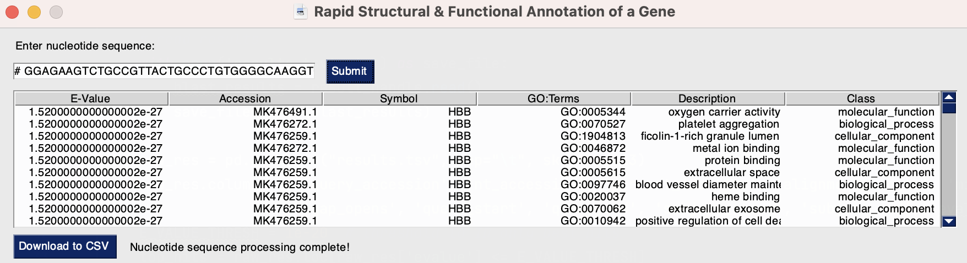
Results
BRCA2 fragment
Hbb

Slide 15
Limitations
Next Steps
Choice of biological molecule
File sizes
Time efficiency
Some web dependency
Utilize protein/amino acid sequence
include more metrics from blast in output
E-value alone may not be enough
Adjust E-value threshold
Include option to upload sequence as FASTA file
Incorporate GO parser modules
from BIOpython
DNA vs protein
Allotted CPU time for BLAST

